Slide 1
PLANNING AND PARTICIPATION
CAMEROON HACKATHON 2022
Gresa Neziri
Urban Planner, data analyst
nezirigresa@gmail.com
+38349558160

Slide 2
Overview
What is planning?
Stakeholder engagement
Participatory planning
Playful participation - Serious Gaming

Slide 3

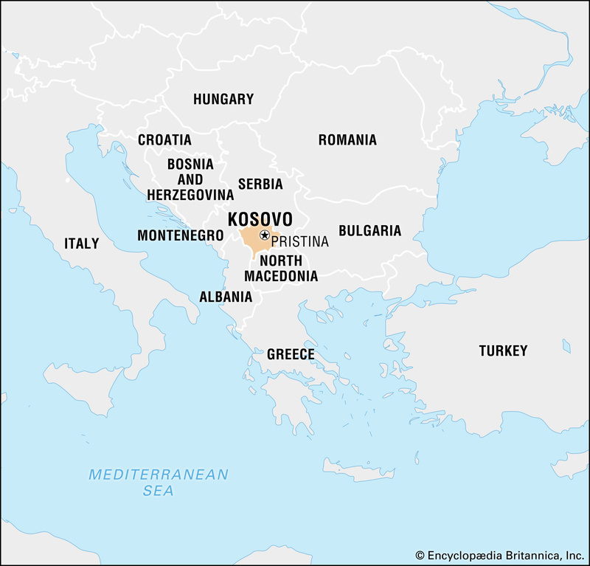
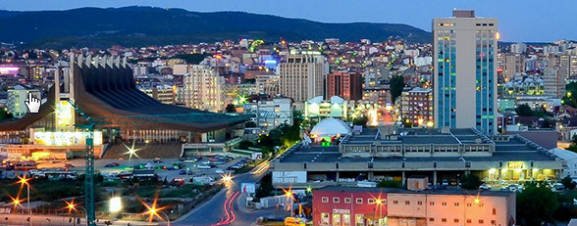
WHO AM I?
Gresa Neziri
Architecture
Urban Planning
Geo-Information and Earth Observation
Institute for Science and Technology INSI
Metriks data
SpaceSyntaKs

Slide 4
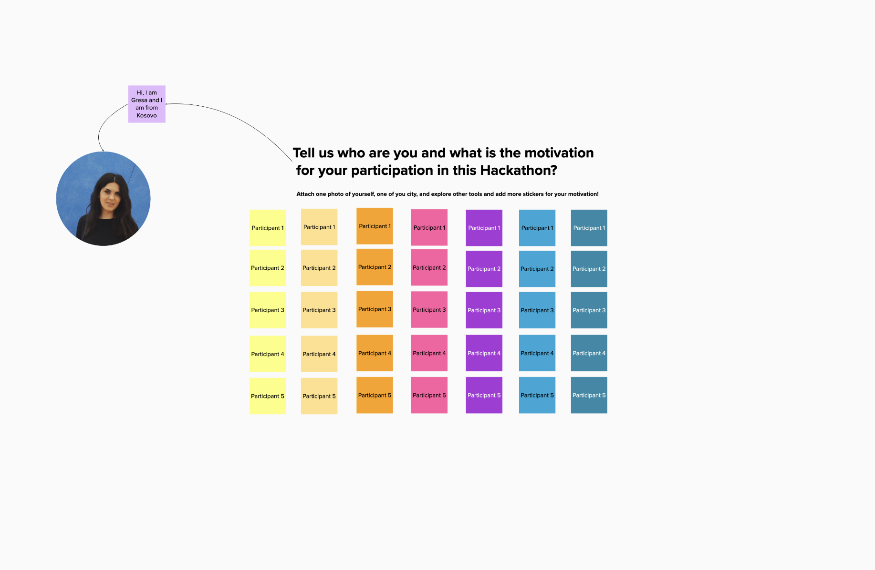
WHO ARE YOU?
TELL ME HERE

Slide 5
WHAT IS PLANNING?
(LEWIS HOPKINS)
It identifies a decision that should be made in the light of other concurrent or future decisions.
Spatial planning decisions are made at the national, regional and local levels.
The spatial visions of the government, provinces and municipalities describe the spatial developments they expect as well as how these developments will be directed or implemented.
Spatial visions are policy papers (of the government), the regional plans (of the provinces) and the structure plans (of the municipalities).

Slide 6
WHAT DOES PLANNING TRY TO DO?
(LEWIS HOPKINS)
Regulation of land use rights
Planning by negotiation and contract
Conflict management
Effective Spatial Planning
Strategies for place making
Place making
Planning by multi-stakeholder collaboration

Slide 7
PLANNING DEALS WITH WICKED PROBLEMS
The kinds of problems that planners deal with—societal problems--are inherently different from the problems that scientists and perhaps some classes of engineers deal with.
Planning problems are inherently wicked.
Key Urban Challenges
1. Environment
2. Economy
3. Institutional structure
4. Civil society

Slide 8
FIVE CHARACTERISTICS OF PLANNING
(LEWIS HOPKINS)
1. Planning systems (Levels of planning)
2. Planning instruments
3. Planning legislation (frameworks, acts, guidelines)
4. Planning processes
5.Actors in planning: Different stakeholders, participation

Slide 9
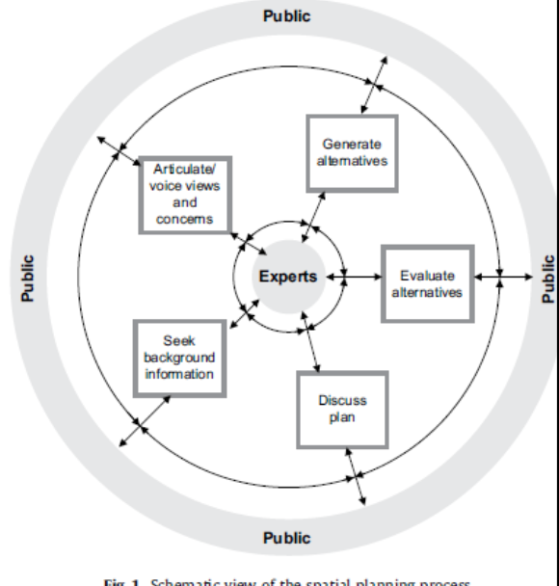
METHODS OF INVOLVING DIFFERENT STAKEHOLDERS IN THE PROCESS
Participatory planning
• designed to empower stakeholders
• by elevating them to the level of decision-makers
• through direct engagement and dialogue between stakeholders and public agencies
• to develop ideas, active involvement, and participation in the community planning process (Innes & Booher 2000).

Slide 10
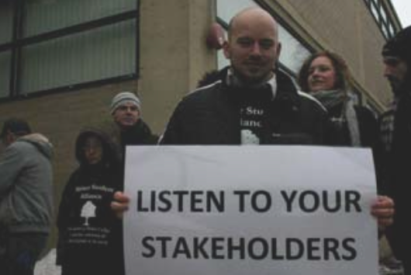
STAKEHOLDERS
Literally:
“Those with a stake in the decisions”
Any individual or group who can affect or is affected by the actions, decisions, policies, practices or goals of originations (Carroll, 19993).
individual or group
affect or is affecting
actions, decisions, ....
Stakeholders have different, often conflicting “stakes”

Slide 11
ADVANTAGES OF PARTICIPATORY PLANNING
Cullen et al. 2010
to resolve conflict because it provides a forum to allow stakeholders to negotiate agreements that meet the interests of all parties
increases the likelihood of successful implementation
agreements reached through collaborative planning may be of higher quality
collaborative planning can generate social capital through improved stakeholder relations, new communication skills, and better information.

Slide 12
LIMITATIONS OF PARTICIPATION
Demands from the participants
knowledge, capability
time, resources
Representativeness
Proper participants are needed
Risk for dominant actors, extreme opinions
Involving the hard-to-reach groups
Type of decisions
Concrete vs. abstract
Operational vs. strategic
Creation of expectations
Consultation versus co-deciding
participation versus representative democracy

Slide 13
HOW TO INVOLVE STAKEHOLDERS IN PLANNING
Public Participation techniques
a. Media – flyers – newsletters
b. Field visits
c. Surveys, Interviews
d. Public meetings, incl. hearings
e. Exhibits/displays
f. Workshops and brainstorms
g. Focus groups
Depends on:
Type of stakeholder
Purpose
Phase of planning and decision-making
h. Strategic meetings
i. Community surveys and referenda/polls
j. Internet surveys/
k. Internet polls
l. Citizen advisory committees/juries

Slide 14

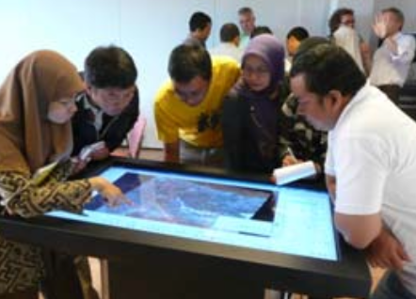
COLLABORATIVE PLANNING IN THE GROUP DECISION ROOM
Towards interactive decision support
GI TOOLS/METHODS FOR COLLABORATIVE PLANNING
MULTIMEDIA PLATFORMS - SERIOUS GAMING

Slide 15
SERIOUS GAMING AS A PLAYFUL PUBLIC PARTICIPATION TOOL
Main definition of game
A game is an activity among two or more independent decion-makers seeking to achieve their objective in some limiting context.
C.abt(1970)
Serious games
Applying games and simulations technology to non-entertainment domains results in serious games.
The main idea of serious dames is to get players to learn something, and, if possible have fun while doing it.

Slide 16
ELEMENTS OF PLAYFUL PARTICIPATORY PLANNING
Attract more citizens in planning
Play and game
Storytelling: sophisticated multimedia storytelling including 3d visualizations, voice, music, virtual reality
Walking and moving: movable planning
Drawing and scetching
Applications range from education, health, public policy, strategic communication, cultural heritage etc.

Slide 17
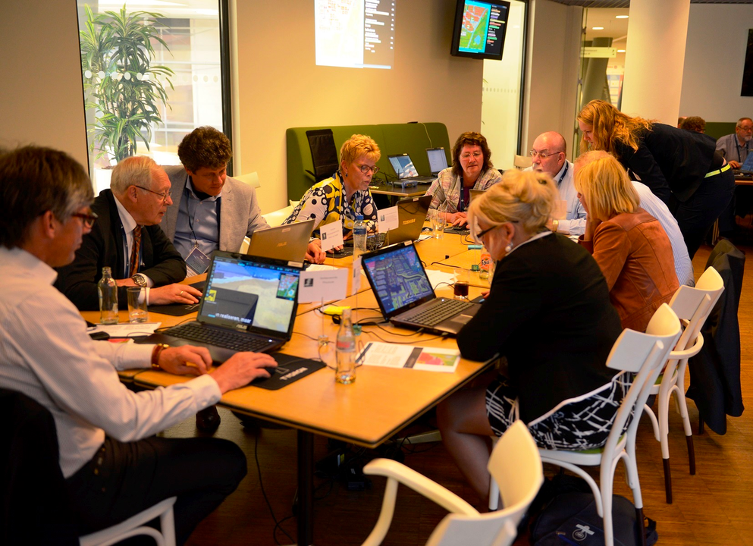

SERIOUS GAMING: IMPROVING STAKEHOLDER COMMUNICATION
Analog
Digital

Slide 18
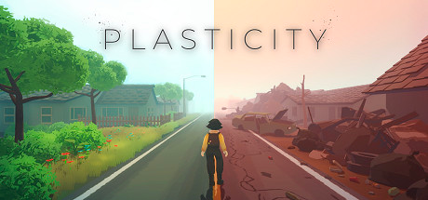
URBAN PLANNING SERIOUS GAMES ONLINE
SimCity
PlastiCity
Urban Plans
Minecraft
City Creator
Super City
Nation States

Slide 19
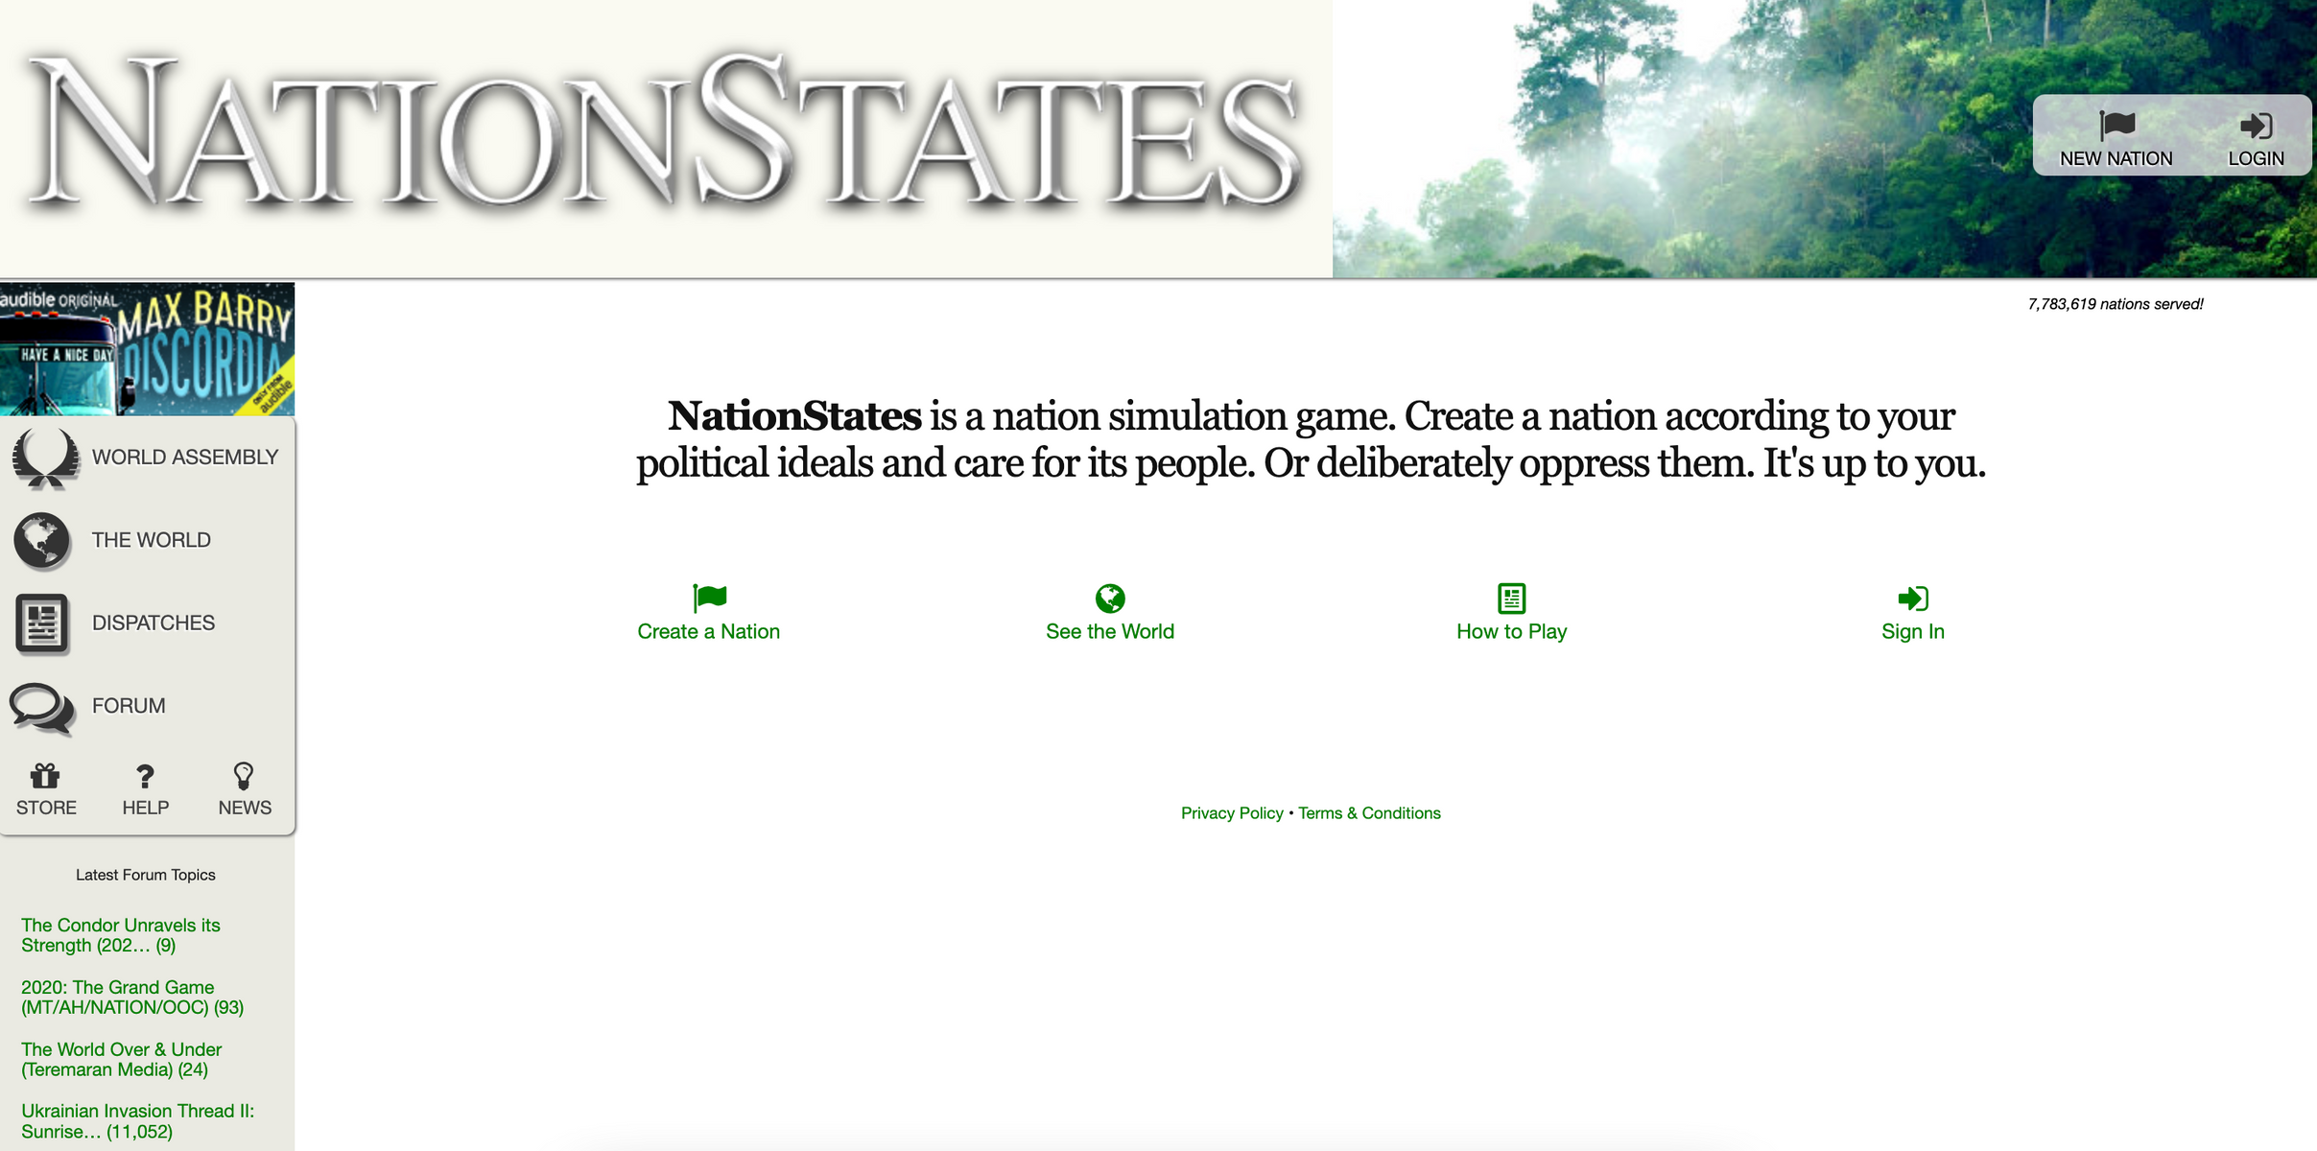

Slide 20



Thank you!

